Slide 1
Learning Processes-2
091601
  by Huafu Chen
SLST
UESTC, China

Slide 2
Credit-Assignment Problem（分配问题）
Learning paradigms（范例）
Problems of assigning credit or blame for overall outcomes to each of internal decisions
Two sub-problems
  temporal credit assignment problem:
  many actions are taken; which action is responsible the outcome
The temporal credit assignment problem is relevant when there are many actions taken by a learning machine that result in certain outcomes, and we must determine which of these actions were responsible for the outcomes
Notes:
信任assignement 问题 是 将导致整体输出 的信任 和 责任 分配给 每一个由学习机器 作出的内部决策 及那些对整体输出起作用的决策的问题.
信任赋值 问题 也被称作 装载问题, 即 将一组给定的训练数据 “装载” 给网络的自由参数.
temporal credit assignment 时间信任付值

Slide 3
Credit-Assignment Problem（分配问题）
Learning paradigms（范例）
  structural credit assignment problem : internal structure of action
  multiple components are contributed; which one do best
  assignment of credit to internal decisions:
    a multicomponent learning machine,
    we must determine precisely which particular component of the system should have its behavior altered
    and by how much in order to improve overall system performance.

Slide 4
Credit-Assignment Problem（分配问题）
Learning paradigms（范例）
    Combined temporal and structural credit-assignment problem :
    existed in distributed learning machine that attempts to improve its performance.
CAP occurs in Error-correction learning
in multiple layer feed-forward NN
  How do we credit or blame for the actions of hidden neurons ?
  ( Details shown by BP algorithm of chapter 4)
Notes:
Combined temporal and structural credit-assignment problem :
existed in distributed learning machine that attempts to improve its performance in situations involving temporally extended behavior.

Slide 5
Learning with Teacher
Learning paradigms
Supervised learning
Teacher has knowledge of environment to learn
input and desired output pairs are given as a training set
Parameters are adjusted based on error signal step-by-step
System performance measure
  mean-square-error
  sum of squared errors over the training samples
  visualized as error surface with parameter as coordinates

Slide 6
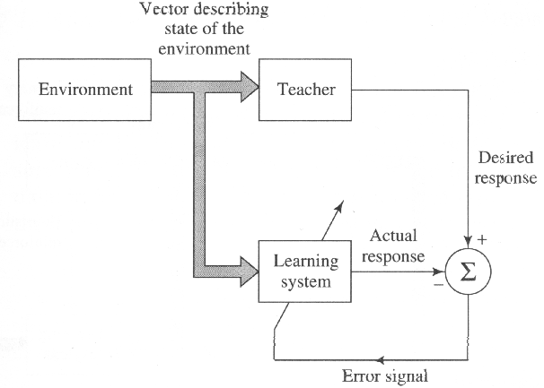
Learning paradigms
Move toward to a minimum point of error surface
  may not be a global minimum
  use gradient of error surface - direction of steepest descent
Good for pattern recognition and function approximation
Fig. 2.6 Framework of supervised learning
Notes:
Figure 2.6 (page 63)

Slide 7
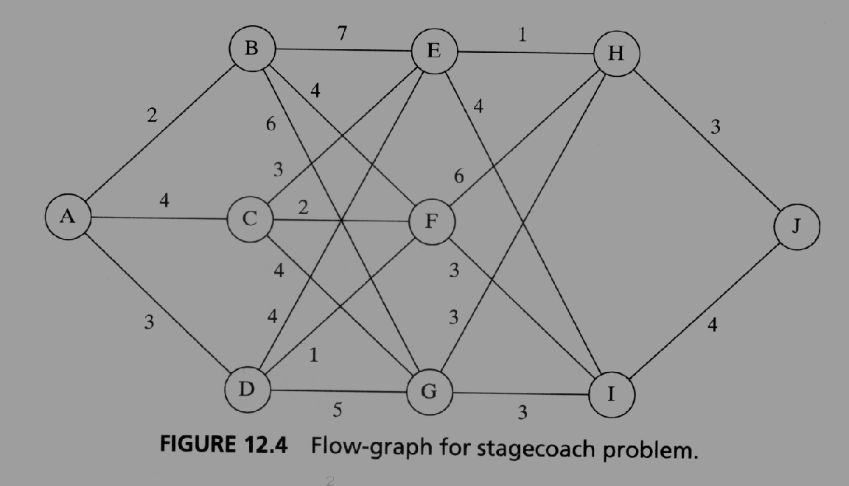
Learning without Teacher
Learning paradigms
1.Reinforcement(强化）learning
/neurodynamic programming
Example: Page 614
stagecoach problem (example 12.1) （ minimize cost to go)
Notes:
Chapter 12
增强式学习是一种 “行为”学习问题, 通过学习系统与环境的交互作用完成任务,尽管存在不确定性,但学习系统仍然希望在环境中达到特定的目标, 无教师/监督情况下进行的交互使得 增强式学习特别适合代价很高或很难(如果不是不可能)找到一组满意的输入-输出样本的动态情况.
增强式学习 的传统方法(通过惩罚和奖励的过程进行学习 以期达到 高度熟练行为 的目的 ) 植根于 心理学,可追溯到 Thorndike (1911)关于动物学习早期的工作 和 Pavlov(1927)关于条件反射的研究.
增强式学习 的现代方法,基于动态规划,通过考虑将来可能的但实际并未经历的阶段而决定一系列的行动, 这里强调的是规划.
神经动态规划(chapter 12) : 动态规划作理论支撑, 神经网络提供它的学习能力
动态规划问题 (dynamic programming) 技术处理是 :分阶段做决策,在做下一个决策之前在某种程度上能够预测每个决策的结果. 这种情况的一个关键方面是不能孤立地做出决策.相反, 现在对低代价的希望很可能被将来高代价的失望所抵消(即不能仅仅追求当前的低代价), 这是一个信任(credit assignment) 问题, 因为信任或责任 必须assign给一组相互作用的决策中的每一个决策. 为了最优的规划,需要在眼前代价与将来代价中取得有效的折中.
stagecoach problem 驿车问题
The problem:
1) The environment evolves probabilistically occupying a finite set of discrete state.
2) For each environmental state there is a finite set of possible actions that may be taken by the learning system.
3) Every time the learning system takes an action, a certain cost is incurred.
4) States are observed, actions are taken, and costs are incurred at discrete times.

Slide 8
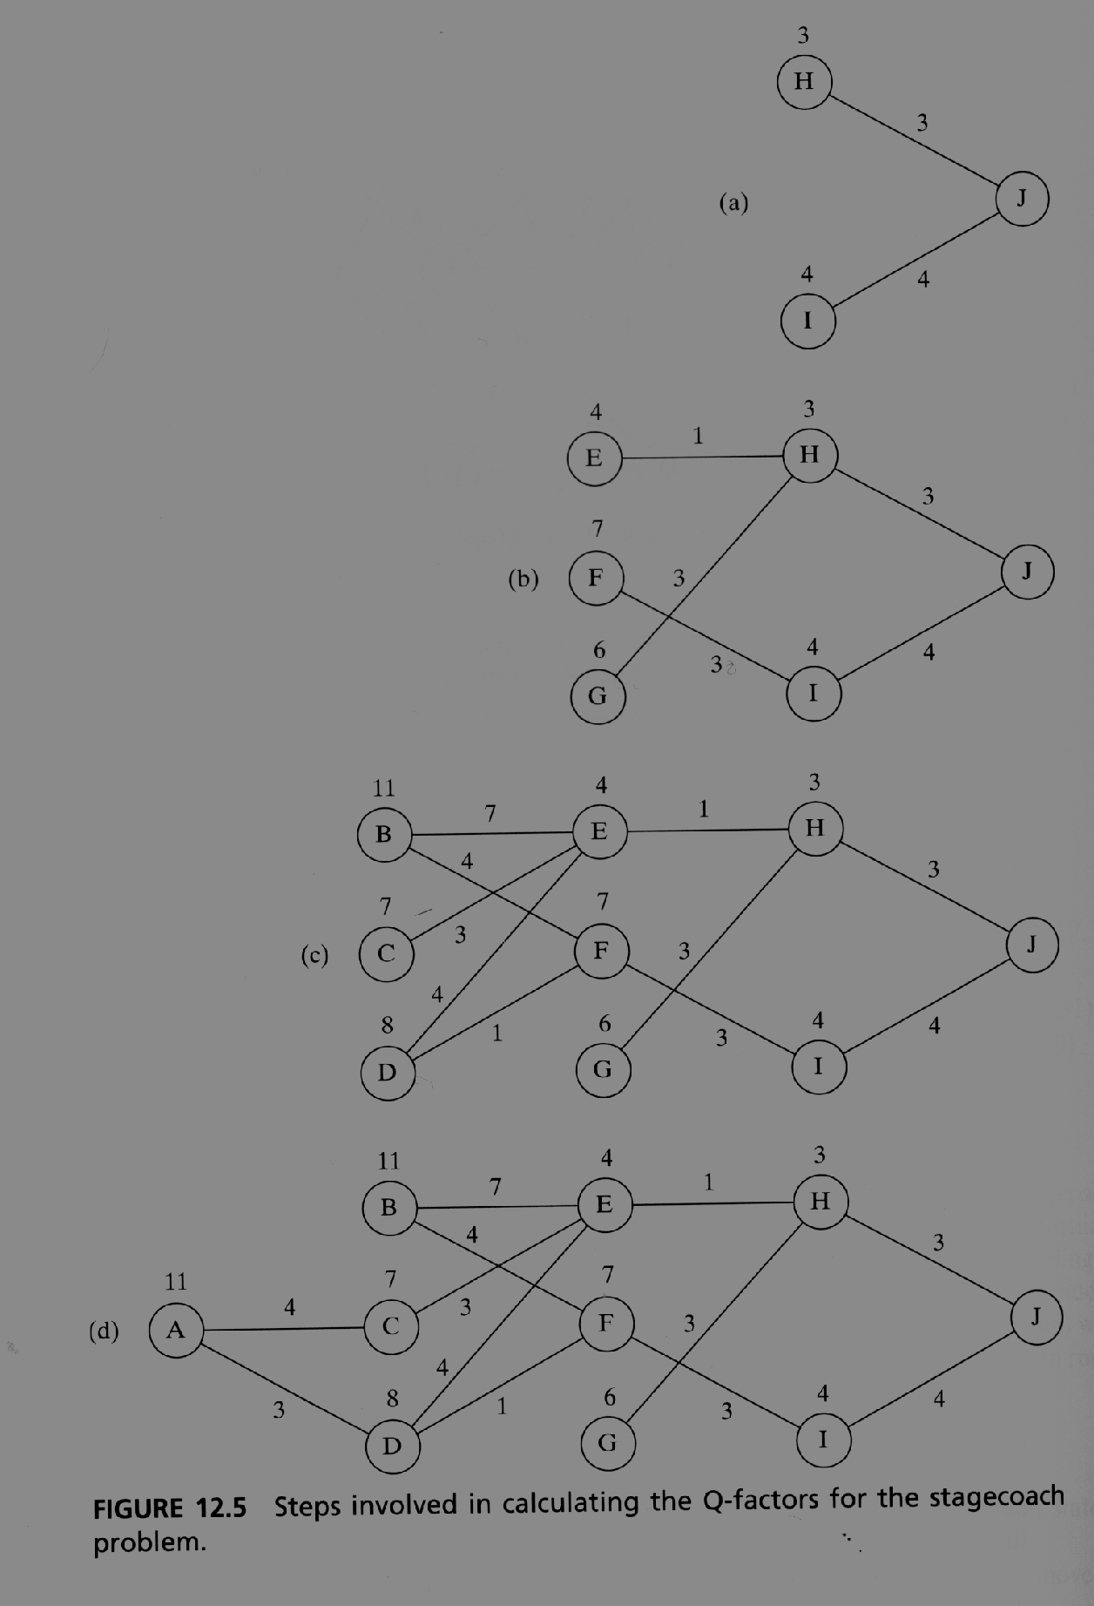
Example: Page 614
Notes:
Chapter 12
增强式学习是一种 “行为”学习问题, 通过学习系统与环境的交互作用完成任务,尽管存在不确定性,但学习系统仍然希望在环境中达到特定的目标, 无教师/监督情况下进行的交互使得 增强式学习特别适合代价很高或很难(如果不是不可能)找到一组满意的输入-输出样本的动态情况.
增强式学习 的传统方法(通过惩罚和奖励的过程进行学习 以期达到 高度熟练行为 的目的 ) 植根于 心理学,可追溯到 Thorndike (1911)关于动物学习早期的工作 和 Pavlov(1927)关于条件反射的研究.
增强式学习 的现代方法,基于动态规划,通过考虑将来可能的但实际并未经历的阶段而决定一系列的行动, 这里强调的是规划.
神经动态规划(chapter 12) : 动态规划作理论支撑, 神经网络提供它的学习能力
动态规划问题 (dynamic programming) 技术处理是 :分阶段做决策,在做下一个决策之前在某种程度上能够预测每个决策的结果. 这种情况的一个关键方面是不能孤立地做出决策.相反, 现在对低代价的希望很可能被将来高代价的失望所抵消(即不能仅仅追求当前的低代价), 这是一个信任(credit assignment) 问题, 因为信任或责任 必须assign给一组相互作用的决策中的每一个决策. 为了最优的规划,需要在眼前代价与将来代价中取得有效的折中.
stagecoach problem 驿车问题
The problem:
1) The environment evolves probabilistically occupying a finite set of discrete state.
2) For each environmental state there is a finite set of possible actions that may be taken by the learning system.
3) Every time the learning system takes an action, a certain cost is incurred.
4) States are observed, actions are taken, and costs are incurred at discrete times.

Slide 9
Primary reinforcement
Environment
Critics
Heuristic（启发式的）
reinforcement
Learning
Systems
The state of the environment is defined as a summary of the entire past experience of the learning system (learn to program) gained from its interaction with the environment,
such that the information necessary for the learning system to predict future behavior of the environment is contained in that summary.
Notes:
原始增强信号
启迪增强信号
Bellman (1957) Principle of optimality: 一个最优策略有这样的性质,无论初始状态和初始决策是什么, 对于第1个决策所导致的状态,剩余决策必须成为最优策略.
Critic—评价

Slide 10
In reinforcement learning（增强式学习）,
the learning of an input-output mapping is performed through continued interaction with the environment in order to minimize a scalar index of performance.
The above Fig2-7/Fig.12-4 shows one form of a reinforcement learning system
built around a critic (cost )/评价 that
converts a primary reinforcement signal （原始增强信号） received from the environment into a higher quality reinforcement signal called the heuristic reinforcement signal（启迪性增强信号）.

Slide 11
The goal of learning is to minimize a cost-to-go function, defined as the expectation of the cumulative cost of actions taken over a sequence of steps instead of simply the immediate cost.
This learning paradigm is difficult to perform for a basic reason: no teacher to provide a desired response at each step of the learning process.
However, it is very appealing. It provides the basis for the system to interact with its environment, thereby developing the ability to learn to perform a prescribed task solely on the basis of the outcomes of its experience that result from the interaction.
Notes:
用于神经动态规划

Slide 12
Reinforcement learning is closely related to dynamic programming. Details may be found in examples in Ch 12
Reinforcement(强化） learning/neurodynamic programming
  No teacher to provide direct (desired) response at each step
    example : good/bad, win/loose
  must solve temporal credit assignment problem
    since critics may be given at the time of final output

Slide 13
Learning without Teacher
Learning paradigms
2 unsupervised or self-organized learning
there is no external teacher or critic to oversee the learning process, as indicated in Fig.2.8 as follow.
Vector describing state of the environment
Environment
Learning
Systems

Slide 14
Unsupervised Learning
Learning paradigms
perform unsupervised learning
by competitive learning rule
We may use a neural network that consists of two layers – an input layer and a competitive layer.
The input layer receives the available data.
The competitive layer consists of neurons that compete with each other for the “opportunity” to respond to features contained in the input data according to a learning rule such as a” winner –takes all”.

Slide 15
Unsupervised Learning
Learning paradigms
Different algorithm for unsupervised learning are described in chapters 8 through 11(PCA, ICA, OSM, BM).
Self-organized mapping (SOM, chapter 9)
  No external teacher or critics
  Task-independent measure of quality is required to learn
  Network parameters are optimized with respect to the measure
  competitive learning rule is a case of unsupervised learning

Slide 16
Learning Tasks
Pattern Association
Pattern Recognition
Function Approximation
Control
Filtering
Beamforming

Slide 17
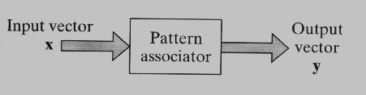
Pattern Association（联想）
Learning Tasks
Associative memory is distributed memory that learns by association
  predominant features of human memory
x_{k} → y_{k,} k=1, 2,…, q
Storage capacity, q
Fig.2.9 (page 67)

Slide 18
Pattern Association（联想）
Learning Tasks
Two phases: Storage phase and Recall phase
  NN is required to store a set of patterns by repeatedly presenting
  partial description or distorted pattern is used to retrieve the particular pattern
    x_{k} acts as a stimulus that determines location of memorized pattern

Slide 19
Pattern Association（联想）
Two styles:
1) Autoassociation : when x_{k} = yk, (competitive learning/ unsupervised)
2) Hetroassociation : when x_{k} ≠ y_{k, （ supervised learning)}
Have q as large as possible yet recall correctly

Slide 20
Pattern Recognition
Learning Tasks
Process whereby a received pattern is assigned to one of prescribed classes (categories)
Humans are good in pattern recognition. We are often able to do so almost immediately and with practically no effort.
For example:
recognize the familiar face of a person even though that person has aged since our last encounter,

Slide 21
Pattern Recognition
Learning Tasks
For example:
identify a familiar person by his or her voice on the telephone despite a bad connection
distinguish a boiled egg that is good from a bad one by smelling it.
Humans perform pattern recognition through a learning process; so it is with neural networks.

Slide 22
Pattern Recognition
Learning Tasks
Pattern recognition by NN is statistical in nature
pattern is a point in a multidimensional decision space
decision boundaries - region associated with a class/ classification
decision boundaries are determined by training

Slide 23
Pattern Recognition
Learning Tasks
Two forms of NN to perform a pattern recognition
Feature Extraction
Input
pattern
Classification
Outout
class
Feature
vector
unsupervised
supervised
m-Dimension
q-Dimension
r-Dimension

Slide 24
Pattern Recognition
(a) (approach –1)
The machine is split into two parts an unsupervised network for feature extraction and a supervised network for classification.
{ Generally, q<m, thus dimensionality reduction and data compression step by step }

Slide 25
Pattern Recognition
Learning Tasks
Two forms of NN to perform a pattern recognition
(b) (approach-2) A single multilayer feed-forward network using a supervised learning algorithm.
In this approach, the task of feature extraction is performed by the computational units in the hidden layer(s) of the network.

Slide 26
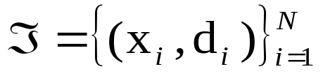




Function Approximation
Learning Tasks
Given set of labeled examples
{ drawn from }
find which approximates unknown function
s.t.
Supervised learning is good for this task
Notes:
Labeled –supervised

Slide 27
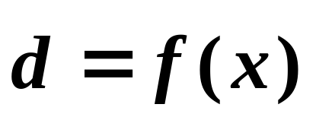
Function Approximation
Learning Tasks
System identification
the input-output relation of an unknown memoryless multiple input---multiple output(MIMO) system;
d_{i}
Unknown
system
e_{i}
Σ
input
NN
model
y_{i}
NN is a big try
of the human brain system identification !!
Notes:
NN is a try of the human brain system identification !!

Slide 28
Function Approximation
Learning Tasks
Construct an inverse system
Output
input
forward
NN model
(Inverse model)
y_{i}
d_{i}
e_{i}
Σ
X_{i}
The error signal vector is used to adjust the free parameters of the neural network to minimize
Notes:
Also a inverse system identification!!
identification the system by construct the inverse system!!

Slide 29
Function Approximation
the squared difference between the outputs of the unknown inverse system/the neural network AND the inputs of the forward system
in a statistical sense, and is computed over the complete training set.
For example: ECG/EEG inverse problem in my opinion.

Slide 30
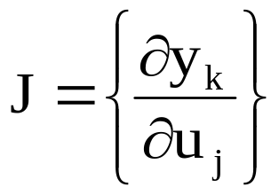
Control
Learning Tasks
Feedback control system
Reference
signal
e
u
Σ
Controller
Plant
y
d
search of Jacobian matrix
  for error correction learning
  indirect learning
    using input-output measurement on the plant, construct NN model
    the NN model is used to estimate Jacobian
  direct learning by NN
Notes:
针对plant 的年input output 构造 NN, 用 NN 来预测plant的变化， system identification,然后去研究control 问题

Slide 31
Filtering
Learning Tasks
Extract information from a set of noisy data
information processing tasks
  Filtering: using data measured up to and including time n
  Smoothing: using data measured up to and after time n
  Prediction: predict at n+n₀ ( n₀ > 0) using data measured up to time n
Notes:
Filtering, smoothing and prediction may be done by NN with supervised learning
Cocktail party problem: without teacher should be done by a un-supervised learning

Slide 32
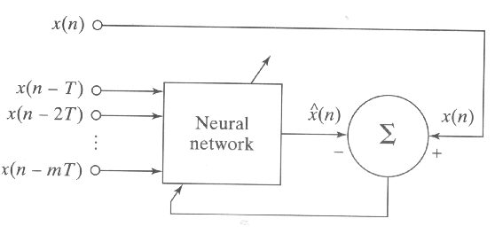
Filtering
figure 2-15
Block diagram of a non-linear predictor

Slide 33
Filtering
Learning Tasks
Example of filtering: Cocktail party problem
  focus on a speaker in the noisy environment
  believed that pre-attentive, preconscious analysis involved
Blind source separation
x₁(n)
u₁(n)
Unknown
mixer
A
Demixer
W
y₁(n)
...
...
...
u_{m}(n)
y_{m}(n)
x_{m}(n)
Fig.2.14 Block diagram of blind source separation
Unknown environment
Notes:
Filtering, smoothing and prediction may be done by NN with supervised learning
Cocktail party problem: without teacher should be done by a un-supervised learning

Slide 34
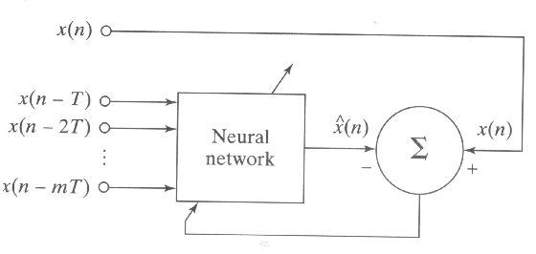
Learning Tasks
Fig. 2.15 Block diagram of nonlinear prediction
Notes:
Constraints PCA and ICA, SCA

Slide 35
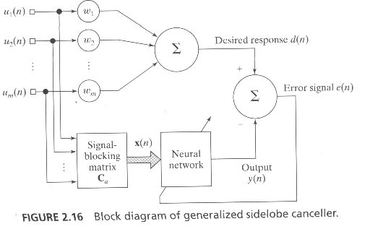
Beamforming/ Beamformer
Beamforming is a spatial form of filtering and it is used to distinguish between the spatial properties of a target signal and background noise.
The system consists of the following components:
An array of antenna elements; 2) A Linear combiner
3) A signal-blocking matrix Ca functioned to cancel interference
Notes:
Constraints PCA and ICA, SCA
3) A signal-blocking matrix Ca, the function of which is to cancel interference that leaks through the sidelobes of the radiation pattern of the spatial filter representating the linear combiner.

Slide 36
Memory
Relatively enduring neural alterations induced by interaction with environment - neurobiological definition
accessible to influence future behavior
activity pattern is stored by learning process
  memory and learning are connected
Long-term memory
  knowledge stored for a long time or permanently
Notes:
Endure 忍受、耐
Enduring 持久的

Slide 37
Memory
Short-term memory
  compilation of knowledge representing current state of environment
  Any discrepancies between knowledge stored in short term memory and a “new” state are used to update the short-term memory.
  Example: MMN mismatch negativity
  ( Talent and smart)
Notes:
Endure 忍受、耐
Enduring 持久的
Compilation 编辑
小聪明 与 大智

Slide 38
Associative memory(联想记忆）
Memory
Memory is distributed
stimulus pattern and response pattern consist of data vectors
information is stored as spatial patterns of neural activities
information of stimulus pattern determines address for its retrieval
although neurons is not reliable, memory is
there may be interaction between patterns stored. (not a simple storage of patterns) There is possibility of error in recall process

Slide 39
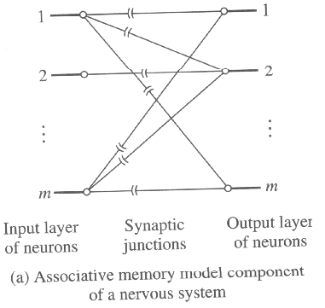
Associative memory(联想记忆）
Memory
Mathematical description
神经系统的联想记忆模型组件
Fig.2.17 Associative memory models
Notes:
神经系统的联想记忆模型组件
使用人工神经元的联想记忆模型

Slide 40
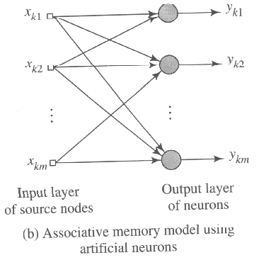

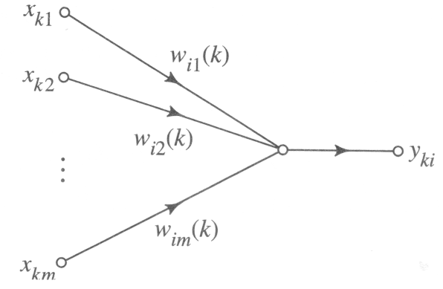

Associative memory(联想记忆）
Memory
(b)使用人工神经元的联想记忆模型
Fig.2.17 Associative memory models
Fig.2.18 Signal-flow graph model of a linear neuron labeled i
Notes:
ANN (2.17(b)) is assumed to be linear, each neuron acts as a linear combiner.

Slide 41
Associative memory(联想记忆）
Memory
n Network dimensionality
Suppose that an activity pattern occurs in the input layer of the network and that an activity pattern occurs simultaneously in the output layer.
Suppose the dimensionalities of the input and output spaces are the same, equal to m.
We refer to m as network dimensionality.
\ Here m equals the number of source nodes in the input layer or neurons in the output layer.

Slide 42
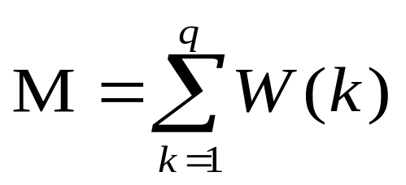
Correlation Matrix Memory
Association of key vector x_{k} with memorized vector y_{k}
( is defined as( principle))
  y_{k} = W(k)x_{k,} k = 1, 2, 3, …, q
Total experience ( q samples)

Slide 43
Correlation Matrix Memory
The memory matrix M defines the overall connectivity between the input and output layers of the associative memory.
It represents the total experience gained by the memory as a result of the presentations of q input-output patterns.
The memory matrix M contains a piece of every input-output pair of activity patterns presented to memory.

Slide 44
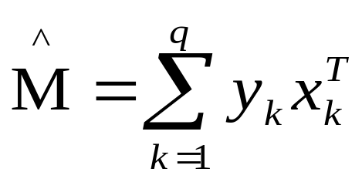
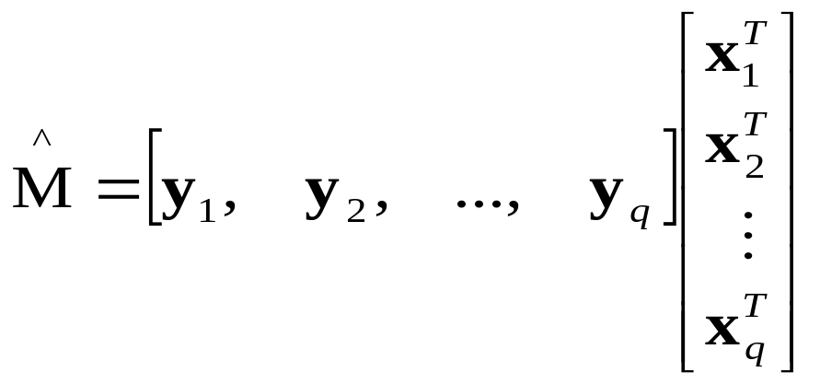

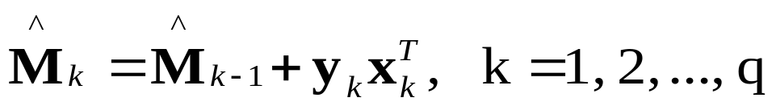
Correlation Matrix memory
Learning
Estimate of memory matrix M
  called Outer Product Rule(definition)
  generalization of Hebb’s postulate of learning

Slide 45
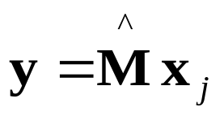
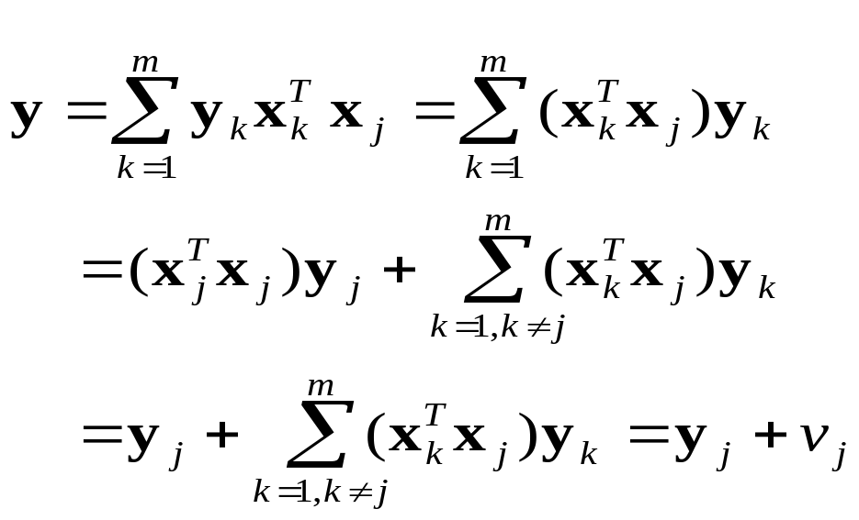
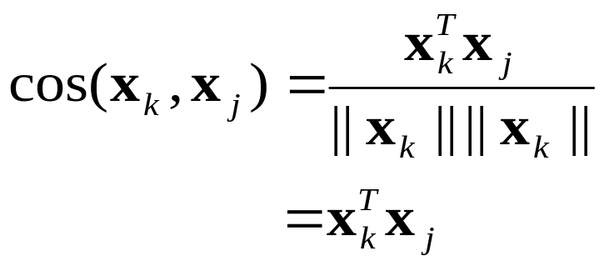
Recall
Normalize x to have unit matrix
defined as v_{j}
Noise Vector
normalized to have unit matrix

Slide 46
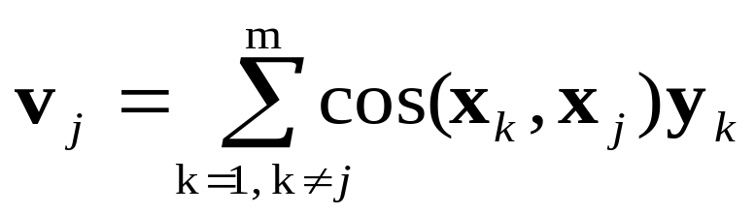
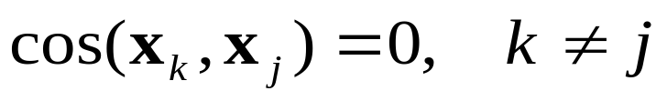
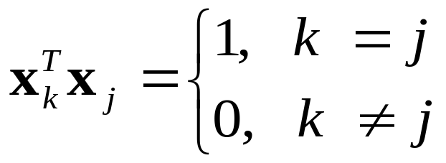
Orthogonal set
Memory
orthogonal set
Storage Capacity
  rank : # of independent columns
  limited by dimensionality of input

Slide 47
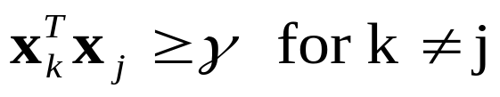
Error of Associative Memory
Memory
Real-life is Neither orthogonal nor highly separated
Lower bound γ
if γ is large, the memory may fail to distinguish
If X_{j}= X₀ +v,
The machine may recognize X₀ and associate Y₀ , memory act as having patterns (X₀ , Y₀) of never seen before Termed animal logic

Slide 48
Adaptation
Space and time : both are fundamental dimensions of the learning process
spatiotemporal nature of learning:
  Examples: control , beamforming, etc.
  Species ranging from insects to humans have an inherent capacity to represent the temporal structure of experience.
  It makes an animal to adapt its behavior to the temporal structure of an event in its behavioral space
  TTC –time to collision?

Slide 49
Adaptation
Stationary system
  An environment whose statistical characteristics do not change with time, the essential statistics can , in theory, be learned by the network under the supervision of a teacher.
  Once the training process has completed, the synaptic weights are frozen. Thus a learning system relies on memory to recall and exploit past experience.
  learned parameters are frozen to be used later

Slide 50
Adaptation
Nonstationary system
  continually adapt its parameters to variations in the incoming signal in a real-time fashion
  Adaptive system /continuous learning;
  learning-on-the-fly/linear adaptive filter
Psudostationary
  consider stationary for a short time window
    speech signal : 10~30 msec
    weather forcasting : period of minutes
Notes:
Fig.2.22

Slide 51
Notes:
Fig.2.23

